Slide 1
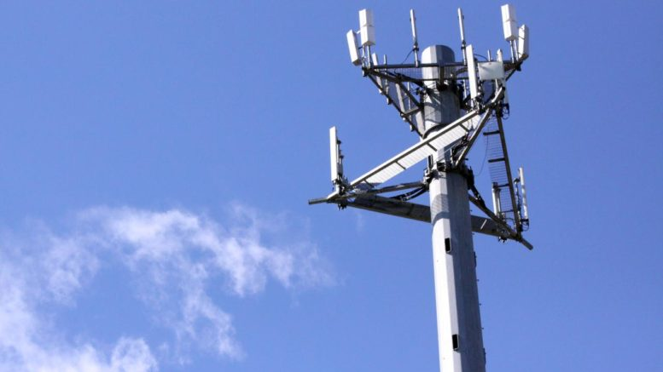
RF Optimization Tool v2.0
Mobile Networks

Slide 2

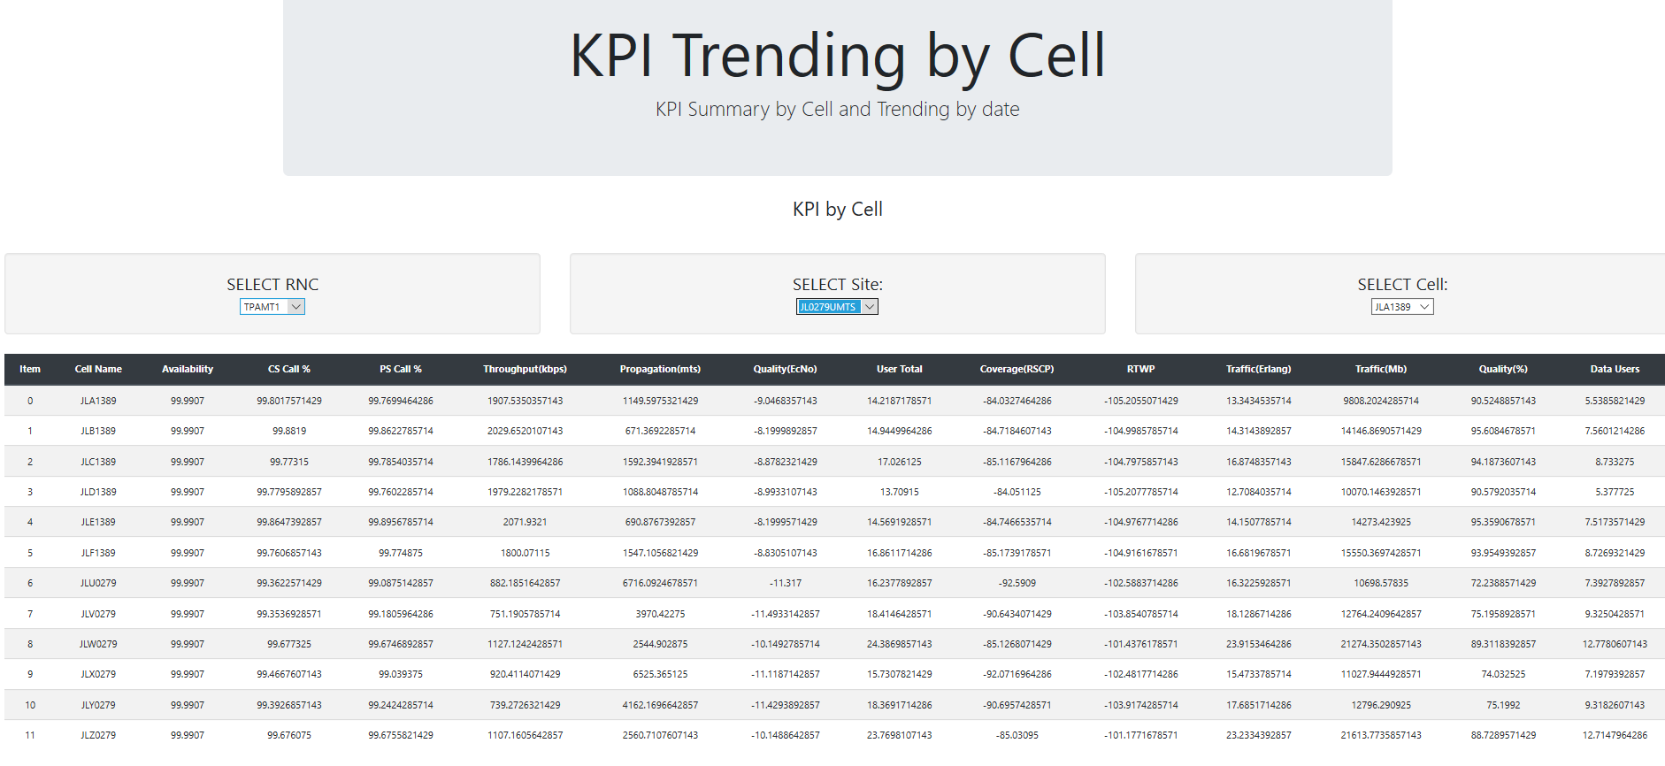
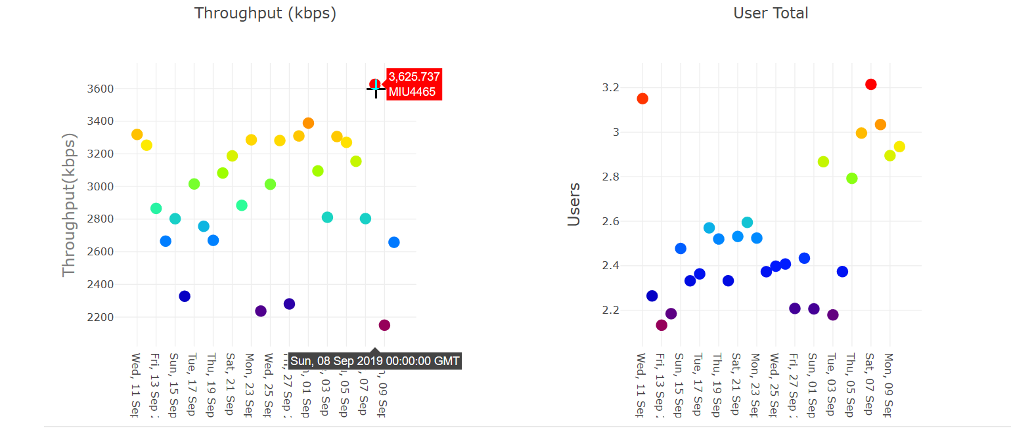
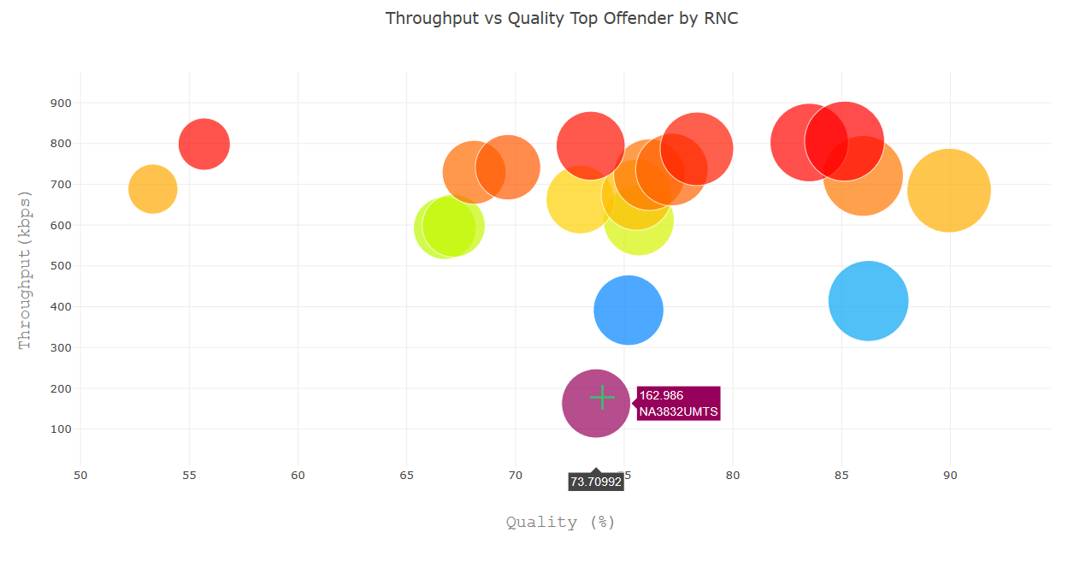
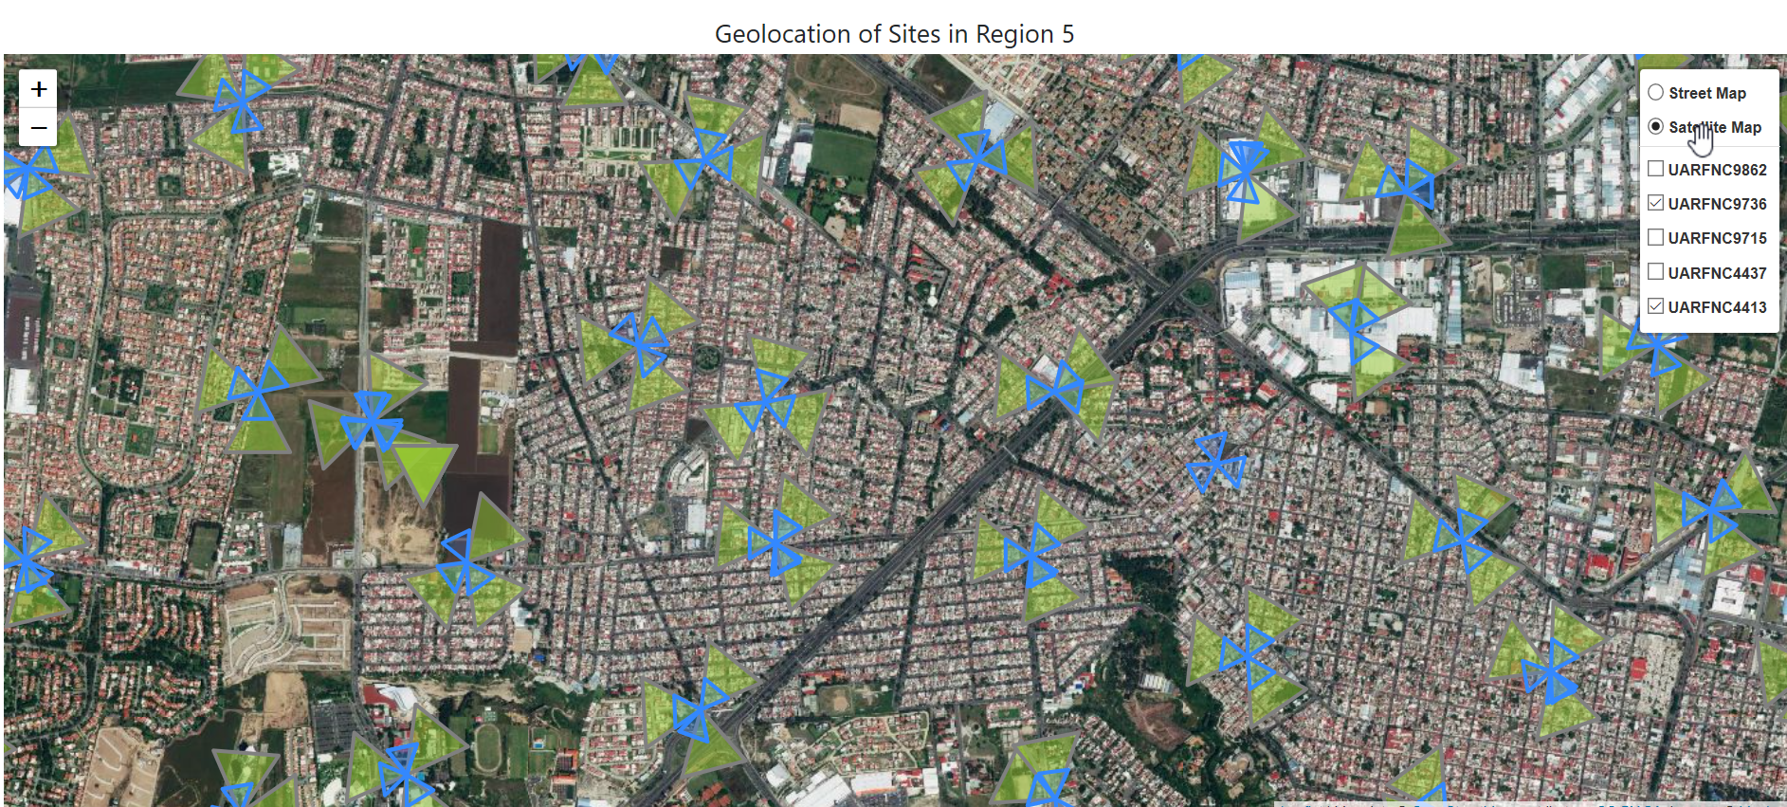
RF Optimization Tool - Enhanced
NEW!
Tilt Calculator
Using Machine Learning
Tool – Tilt Calculator:
Python Flask, Pandas
Machine Learning: Keras, SKLearn
HTML, CSS, Bootstrap.

Slide 3
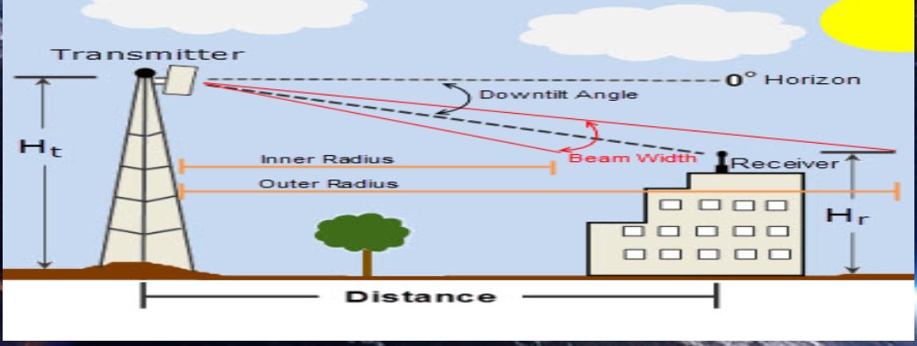
Tilt Parameter
Tilt: Angle between antenna position and tower

Slide 4
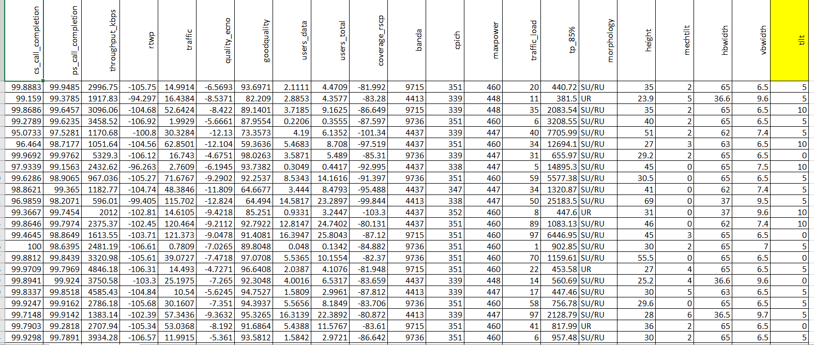
Tilt Calculator – Machine Learning
Y (Tilt):
[0, 5, 10, 15]
X: 19 input parameters
26015 rows
Information splitted into 3 models for better understanding: DenseUrban, Urban and Rural

Slide 5
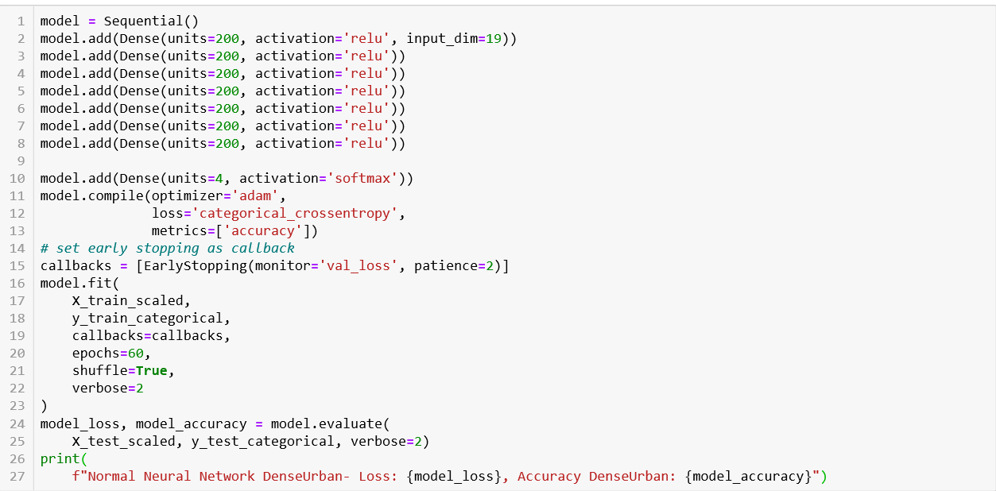
Tilt Calculator – Machine Learning
Learning Deep Neural
6 Hidden Levels

Slide 6
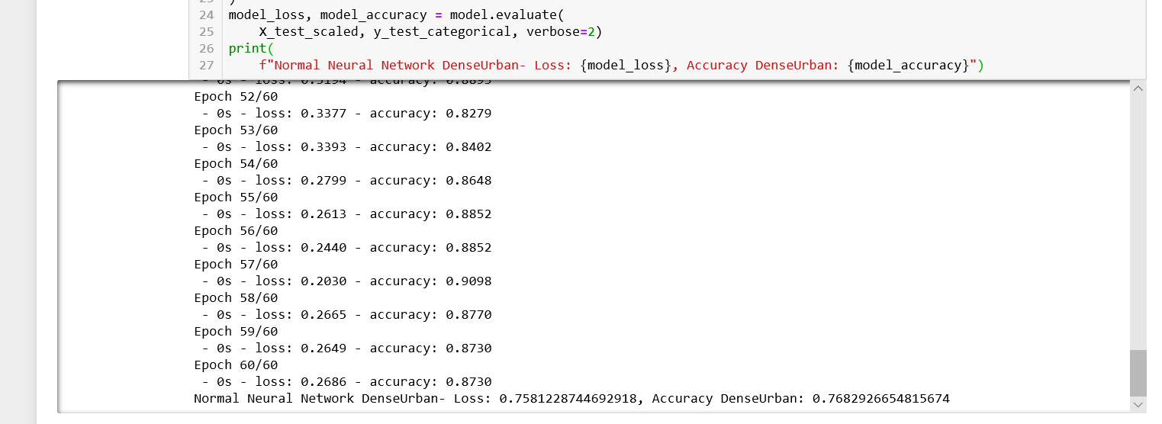
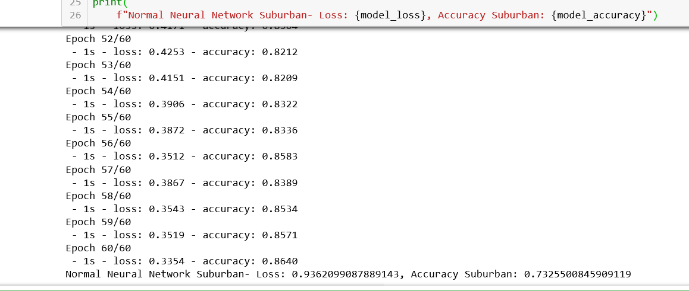
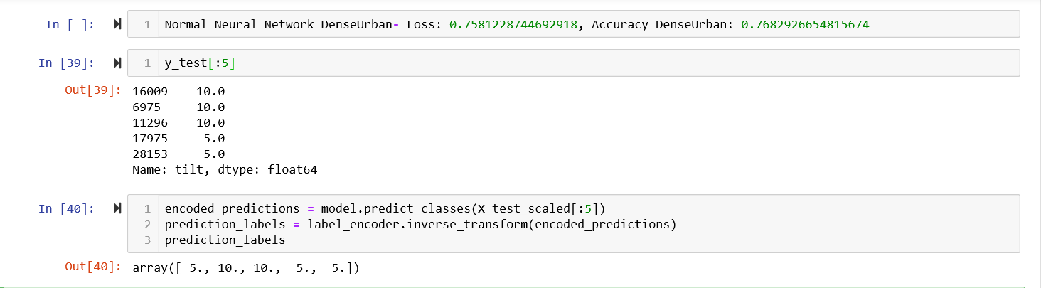
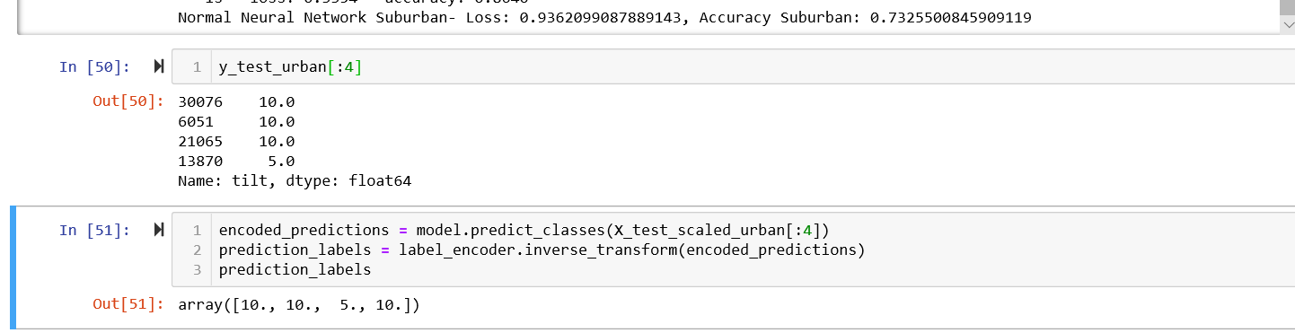
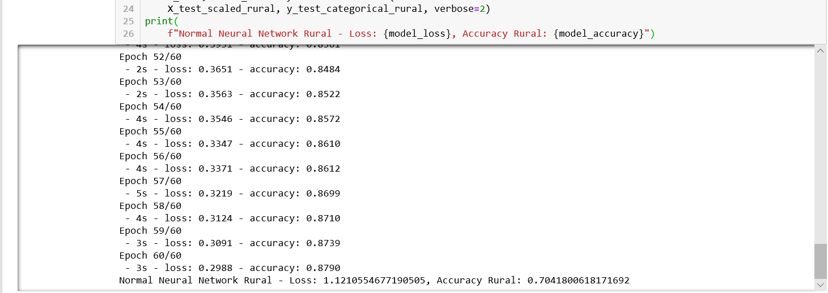
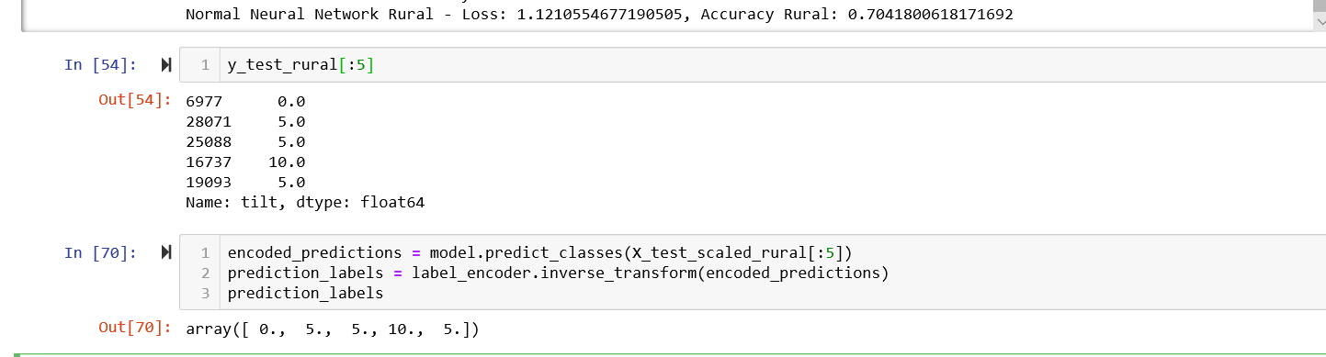
Tilt Calculator – Machine Learning
DenseUrban
Urban
Rural
Stored in *.sav files

Slide 7
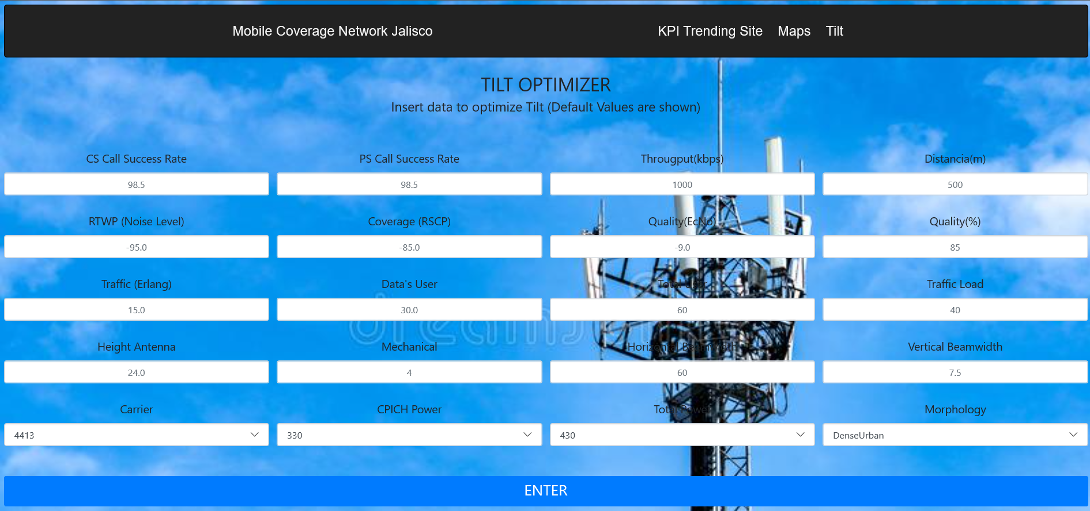
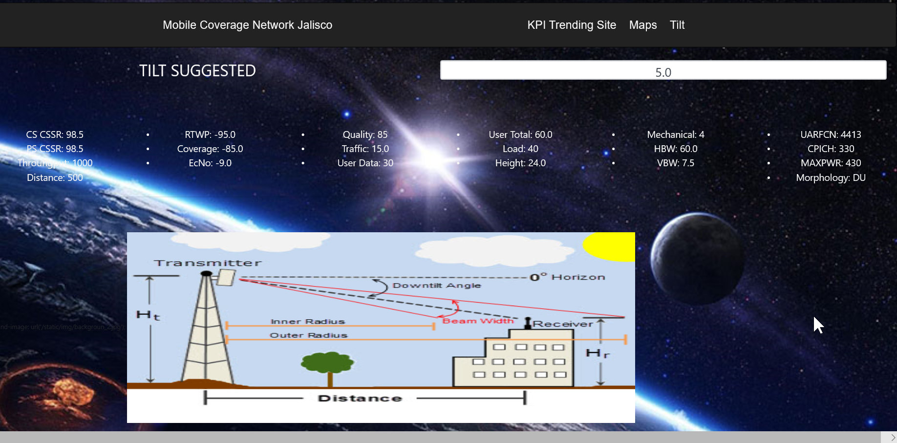
Tilt Calculator - Interface
Input Parameters
Tilt Result

